Slide 1

VISUALIZING TIME USE
AMY RAE FOX
Notes:
Good afternoon everyone, and thank you for coming.
Today I am going to share with you the outcome of my semester project, titled: visualizing time use.

Slide 2





Conceptual framework for psychological investigations of time use
Conceptual
Applied
Techniques for visualizing time use data
How do students use their time?
Empirical
External representations of time use by students
INTRODUCTION
Notes:
The genesis of this project was a manuscript prepared by my committee members. Their paper addressed the topic of time use, and in particular, how university students allocate their time to academic and extracurricular activities. They used survey data gathered on students in the Rhone-Alps region of France, they compared a number of models from social science disciplines to see which could best explain variability in the data.
This paper was recently accepted for publication, the team decided the next step in this research is collecting time use data specifically targeted at addressing factors that might explain variation within and between different fields of study.
I was invited to take on this topic and explore the methods involved in time use research and applications for visualization.
I have organize my resulting work into three sections.
The first is conceptual: I explored the the methods of time use research, and tried to determine how they might be applied for psychological investigations of time use.
The second is applied: I surveyed a number of visualization techniques that might be used to analyze and communicate time use data.
The third is empirical: an exploration of what graphic representations students use to communicate their use of time.
This afternoon I will briefly review the conceptual and applied work, and we will use most of our time discussing the exploratory study. (bonus points to anyone who can keep track of the number of times I use the word time in this presentation ;-)

Slide 3

Conceptual Framework
History of Time Use Research Data Collection Data Analysis
Time Geography Applications
Notes:
I set out this semester to learn everything I could about time, and so of course started with philosophy. From this literature I learned there are a number of perspectives on the ontology and epistemology of time. I also learned that I am not a metaphycicist, and am happy to leave philosophy to the philosophers :-)
I moved on to the psychology literature, hoping to find a more concrete discussion of our experience of time, and the nature of our relationship to time. I found the topic of time has had a long history in psychology research, going all the way back to William James. However, much of the research has focused on issues of perception. The question of time use has received relatively less attention, primarily in applied areas.
Meanwhile, throughout the 20th century researchers in sociology and economics developed sophisticated methods for studying time use in order to compare populations and inform policy decisions.
Since the UPMF team wishes to use these methods for their future data collection, I chose to explore conceptual frameworks for time use research, and find a suitable approach for psychological investigations in the sociological tradition.

Slide 4
Time can be viewed as the ultimate constraint on human activity. Unlike other resources, it is shared equally by everyone. Each of us 24 hours per day.
(United Nations, 2013)

Slide 5



Time Use Research
Informing economic models and social accounting systems
SOCIOLOGY
Exploring differences between societal groups
ECONOMICS
PSYCHOLOGY
Exploring behavioral correlates and determinants
CONCEPTUAL FRAMEWORK
Notes:
Time use research refers the study of how humans use their time in the performance of activities.
The earliest academic study of time use was published in 1924, examining the daily life of workers in Russia (Szalai, 1966).
In the first half of the 20th century, researchers investigating household budgets and living conditions conducted similar studies across Europe and North America.
In the 1960s, the value of time use data to compare populations became apparent, and many countries began collecting large nationally representative samples in conjunction with regular census efforts.
This information is very informative if it can be compared between countries, and so a number of efforts, notably by the EuroStat (the statistics office of the european union) have recommended guidelines for how to collect time use data so it can be more easily compared. The result is a large base of literature, a number of existing datasets and a well-defined methodology (Juster & Stafford, 1991).
In Europe and developing countries, the focus of research has been in sociology, where researchers have explored differences between societal groups. How much time is spent doing household chores by men vs. women?
The resulting data can be compared to results from other countries OR compared to past data sets, to detect differences based on policy changes.
A main finding is that there are very substantial differences among industrialized countries in time use patterns-differences that are often larger than those between particular industrialized and preindustrial economies
In North America, most time-use research has been conducted by economists, interested in informing economic models and social accounting systems.
They seek to answer questions such as: how much time is spent on market vs. non-market work? These results can be compared to other measurements of economic output in order to analyze efficiency and produce models of economic activity.
In general, time-use research involves collection of huge data samples, so that conclusions can be drawn about large populations of individuals.
A smaller body of work is underway in psychology which seeks to evaluate time use at an individual level, investigating how the use of time relates to our subjective wellbeing.

Slide 6
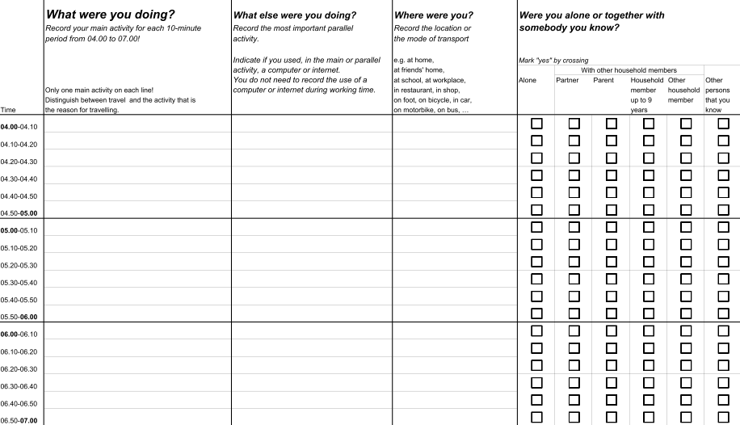
Data Collection
CONCEPTUAL FRAMEWORK
(Eurostat, 2008)
Notes:
There are five methods commonly used to collect time use data: direct observation, experience sampling, surveys, time-stamped electronic databases and time use diaries.
The preferred method for studying an individual’s time allocation is through a time- use diary. The time diary method records the detailed account of the activities undertaken by an individual, usually over a period of 24 hours.
The respondent reports successively all activities either in predetermined fixed time intervals or by indicating the beginning and ending time of each activity.
An advantage of the time diary method is to allow respondents to report activities that they have performed simultaneously, This offers a wealth of analytical opportunities, and are capable of gathering data on the contexts surrounding the activities undertaken, for example, whom people are with, where they are

Slide 7
Data Analysis
duration
timing
sequence
frequency
quantity of time
time of day
order of activities
number of occurrences
How much time do I spend studying ?
What time of day do I study?
What do I do before and after studying?
How many times a day do I study?
CONCEPTUAL FRAMEWORK
Notes:
Hopefully I’ve given you an impression of the potential size and complexity of diary data.
Diaries are immensely powerful instruments, and because of the time and cost associated with delivering them, it is important to have a solid conceptual grounding for an investigation.

Slide 8
As soon as we have come into being we cannot take time off from our bodily existence. We have to leave a space-time trace in the world. And we share this condition with all other living and nonliving entities. As long as something exists it must be somewhere.
(Hägerstrand, 1989, p. 4)
Notes:
In developing the principles of time-geography, Swedish researcher Torsten Hägerstrand proposed a framework for integrating the time and spatial perspectives of multiple disciplines
Fundamental to this perspective is the relationship of an individual to their surroundings.
It is by the very nature of existence that human activity exists equally in time and space.
While it is possible for the researcher to examine duration, sequence, timing and frequency in isolation, and similarly to consider human movement through space without regard to time, in doing so, we risk overlooking important relationships between the use of time and space. By accounting for these dimensions, time-geography provides an effective approach for examining constraints on human activities.

Slide 9
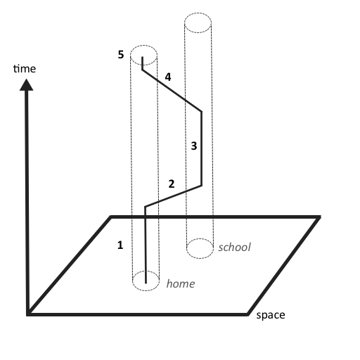
Time Geography
resources goals
activities
constraints path
stations
prisms
CONCEPTUAL FRAMEWORK
(Thrift, 1977)
Notes:
The roots of time-geography lie in the early 1960’s, in the study of migration patterns of a small population in Sweden.
Hagerstrand was a human geographer, who used ethnographic methods to collect the life histories of tens of thousands of individuals. Hägerstrand struggled to analyze his data using existing instruments in geography,
He wanted to account for an individual’s location in space and time
From this experience he constructed the building blocks for a the notational system, and its associated constructs.
Time and space are resources used by humans in daily life. We use resources to perform activities, in pursuit of goals.
Everything we do is considered an activity, and all activities take place in space and time.
Constraints serve as obstacles to progress toward goals, and are the primary determinants of human experience in the environment. Our movement through time and space forms a path which flow through locations in space-time called stations. The potential volume of space and time within reach of the individual constitutes their prism, which graphically expresses their movement limitations in each dimension.
Hägerstrand planted the seeds of an elegant visualization scheme that depicts the path of an individual as a continuous line through time and space.
This figure depicts an individual’s path through time-space over the course of one day. (1) At home, (2) drive to school, (3) at school, (4) drive home, (5) dinner and bedtime. While the individual is stationary the path is perpendicular to the space axis. In this 2D representation, an arbitrary distance differentiates the locations home (1, 5) and school (3). The slope of segments (2) and (4) indicate the individual’s speed as they travel. The length of segment (4) over (2) suggests the individual may have encountered traffic on their drive home.
Hagerstrand’s legacy in time geography is a notational system, its associated constructs, and also a worldview. There is unnecessary fracturing in social science disciplines. As we often study the same phenomena from different perspectives, it is advantageous to seek ways to integrate our perspectives to promote ecological validity in our investigations.

Slide 10
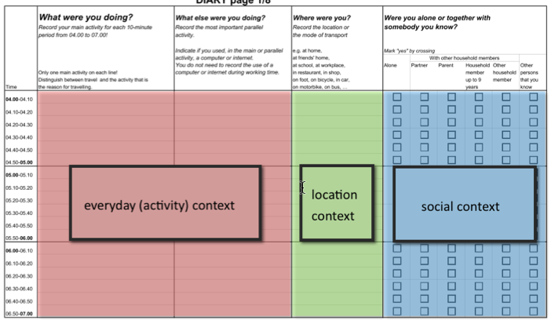
Contexts
mood
tools
. . .
CONCEPTUAL FRAMEWORK
(Eurostat, 2008)
Notes:
Kajsa Ellegard, a student of Hagerstrand, has proposed the application of time geographic principles to time use study.
An assumption is that the individual’s habits may be revealed by the contexts in which activities are actually performed
She describes dividing time use data into a series of contexts, which structure the collection of data.
activity context
location context
social context
etc. etc.
allows for the exploration of : timing, sequence, and frequency in addition to duration, which is the focus of most time use research.

Slide 11
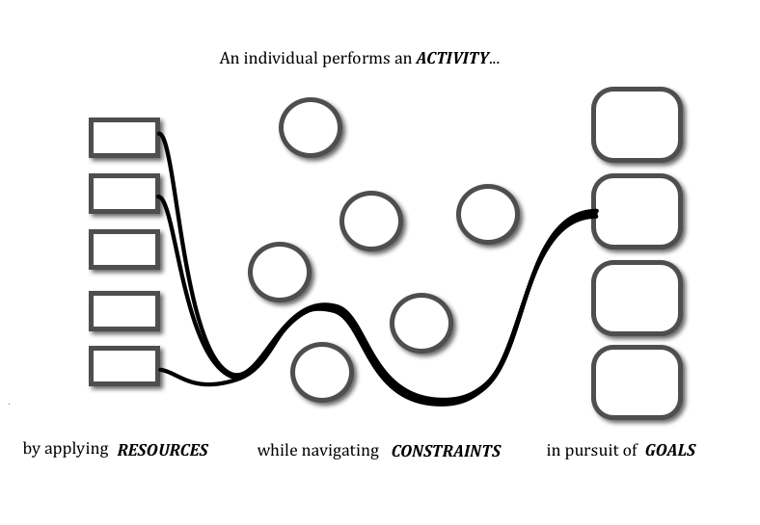
Application
CONCEPTUAL FRAMEWORK

Slide 12
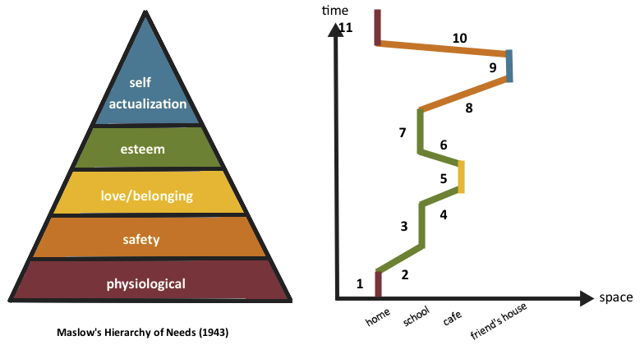
Application
CONCEPTUAL FRAMEWORK
(Maslow, 1943)
Notes:
Say I want to understand my distribution of time in regards to fulfilling my goals.
In this example, we adopt Maslow’s “Hierarchy of Needs” (Maslow, 1943). as a typology for goals.
Figure 6 depicts a day in the life of the author, displayed in a time-geographic notation, with the author’s goal for each activity color-coded in correspondence with Maslow’s hierarchy (at left). In this day, the author: (1) wakes up, eats breakfast, (2) rides bike to school, (3) attends lecture, (4) rides bike to café, (5) meets classmate for lunch, (6) rides bike to school, (7) studies in library, (8) rides bike to friend’s house, (9) designs game with classmate, (10) rides bike home, (11) eats dinner, sleeps.

Slide 13

Notes:
With the wealth of detail available in time use data, and the potential afforded by the proliferation of personal data tracking capabilities, there is a compelling opportunity for a flexible, comprehensive research model for investigating human behavior in time use data.
In developing time-geography, Torsten Hägerstrand’s goal was a deeper understanding of human action, rooted in an ecologically valid worldview. His resulting approach does not seek to explain the motivation of behavior, but rather, serve as a structure for thought.
What is described is potential extensions to Hägerstrand’s work that would allow psychologists to explore time use data using diary methods honed in the broader social sciences, in a way that is grounded in modern theories of cognitive psychology.

Slide 14
Visualization Techniques
Depicting Duration Depicting Context Activity Paths Sequence Analysis

Slide 15
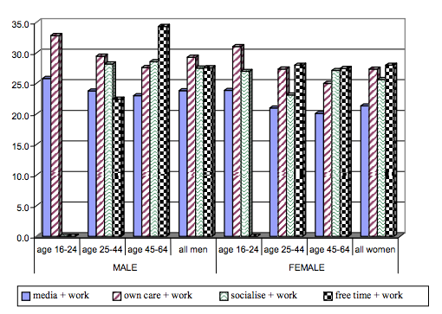
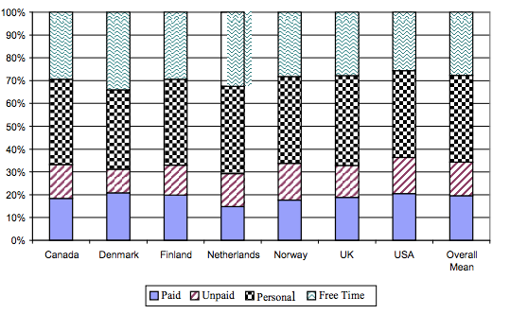
Duration
VISUALIZATION TECHNIQUES
(Fisher & Layte,2004)
Notes:
Figure 1: Average activity duration between countries.
Figure 2: Multitasking activity for different populations groups in England

Slide 16
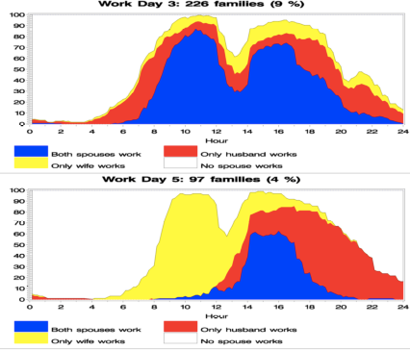
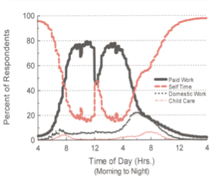
Contexts
VISUALIZATION TECHNIQUES
(Lesnard, L.,2004;Michelson, W., & Crouse, D.,2004)
Notes:
In Figure$7 we see an example from a time use publication which describes four types of activities represented by different color and weight of line for a sample of workers in Canada (Michelson & Crouse, 2004). The graph clearly displays the reciprocal relationship between paid work and selfDtime.
In Figure$8 we find two tempograms using an area variation that depicts two separate workdays for French families in 1985. Color is used to differentiate categories, and we can easily see the distinction between hours of the day when one or both of the spouses are working.

Slide 17
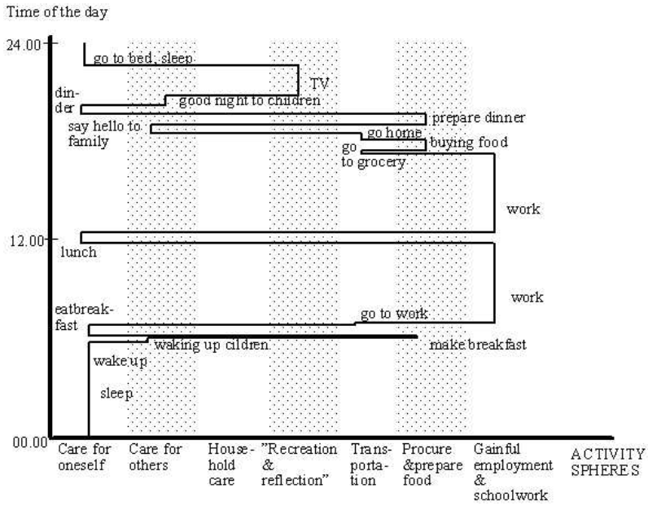
Activity Path
VISUALIZATION TECHNIQUES
(Ellegård & Cooper, 2004)
Notes:
Activity
oriented path of one individual over one day Source:$

Slide 18
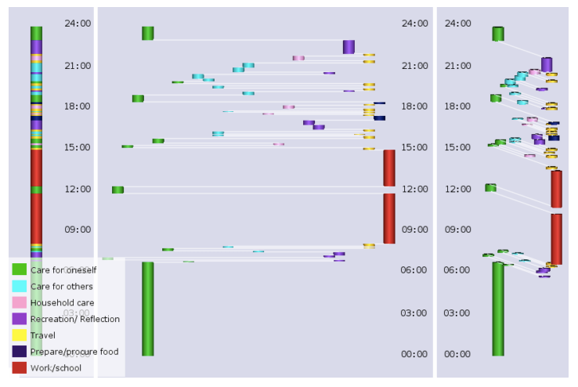
3D Activity Path
VISUALIZATION TECHNIQUES
(Vrotsou, K., Ellegård, K., & Cooper, M, 2009)
Notes:
Visualization examples of the activity path of an individual in VISUAL-TimePAcTS
(a) front (b) side view (c) rotated view
Time is shown on the y-axis and colours represent the 7 activity categories. (a) shows the front view, where the general division of the activities can be detected at main category level. (b) shows the path in side view, reveal- ing the breakdown into more detailed activity descriptions. (c) shows a slightly rotated view of the activity path in 3D.
Source:

Slide 19
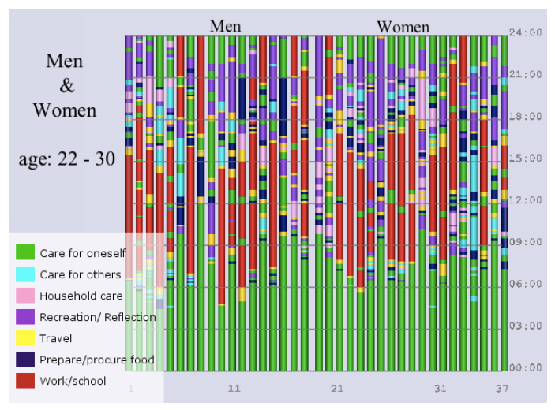
Sequence Analysis
VISUALIZATION TECHNIQUES
(Vrotsou, K., Ellegård, K., & Cooper, M, 2009)
Notes:
Front view visualization of a weekday of a group of individuals aged 22-30 in VISUAL-TimePAcTS
Time is shown on the y-axis, individuals are ordered by sex and age from left to right on the x-axis. Colours represent the 7 activity categories.
Source: Produced using VISUAL-TimePAcTS

Slide 20
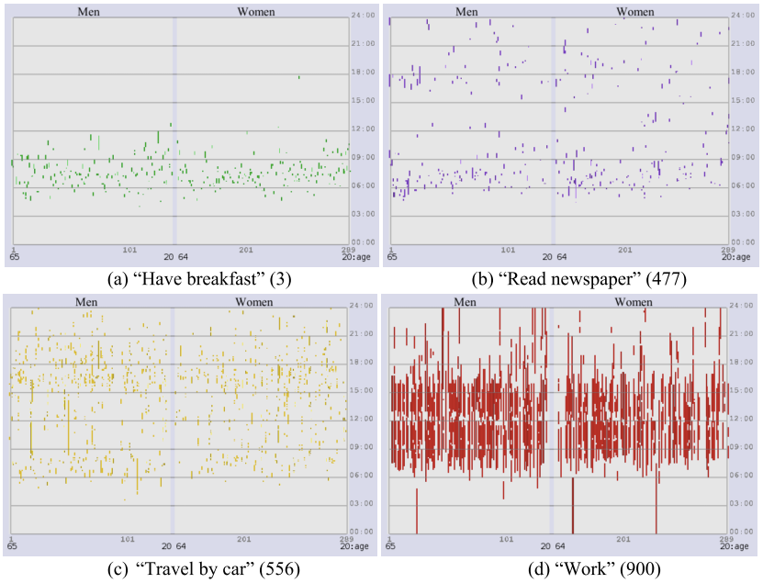
Sequence Analysis
VISUALIZATION TECHNIQUES
(Vrotsou, K., Ellegård, K., & Cooper, M, 2009)
Notes:
Visualization of the distinct single activities making up the collective activity pattern “getting ready for work”: “have breakfast→ read newspaper→ travel by car→ work” (3→477→556→900) in VISUAL-TimePAcTS.

Slide 21
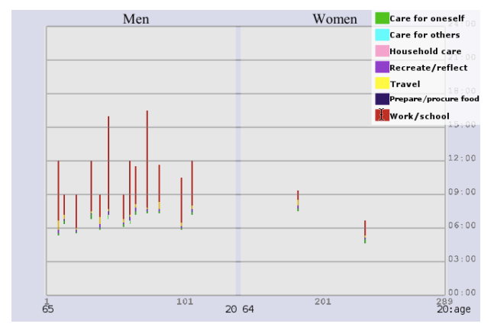
Sequence Analysis
VISUALIZATION TECHNIQUES
(Vrotsou, K., Ellegård, K., & Cooper, M, 2009)
Notes:
Visualization of the 4–tuple “have breakfast→read newspaper→travel by car→work” (3→477→556→900) in VISUAL-TimePAcTS. The constraints applied to the algorithm are: minimum of 15 people performing the tuple, maximum gap of zero between adjacent tuple activities and maximum duration 10 hours. Source: Produced using VISUAL-TimePAcTS.

Slide 22


Slide 23
Empirical Study
Research Question Methods Results Discussion

Slide 24
Research Question
{
}
see hear touch smell taste
If we cannot
time …
how do we communicate it?
What external representations do university students use to communicate their use of time?
EMPIRICAL STUDY
(Tversky, 1991,2011)
Notes:
Time is mysterious. If we cannot experience it through sensory perception, how do we communicate about it?
In language, we use a number of spatial metaphors.
The deadline coming up.
I’m ahead of schedule.
I need to be on time.
I’m looking forward to the weekend.
The best days are behind us.
It seems these spatial metaphors are transferred to the space of the page when we communicate visually.
My empirical study was inspired by the work of Barbara Tversky, who in the early 1990’s studied children of various ages across three cultures. Her team sought to determine what how the children used space and form on the page to communicate their thoughts, including preference, quantity. Her results she found several indications for how the children used space to communicate about time.
Having been given access to a sample of university students, I decided to take the opportunity to do a short exercise, applying Tversky’s observations to the topic of time use.
I asked the question…. what external representations do university students use to communicate their use of time?

Slide 25
Method
Qualitative content analysis of visual media
How do students use space to represent time use?
How do students use form to represent time use?
Is there any consistency in which mechanisms are used to represent each component of time use?
EMPIRICAL STUDY
(Marsh & White, 2006)
Notes:
We decided to conduct an exploratory exercise in conjunction with a pedagogical activity on time management. We expected our participants, third year undergraduates, would be capable of reasoning about, and attempting to represent, their daily activities along the four components of time use. Working with a limited sample of students, we decided on a qualitative approach that would enable us to pilot our materials,and refine our hypotheses. We elected to conduct a qualitative content analysis, as it afforded an iterative deductive/inductive coding process, accommodating novel and unexpected forms of representation (Marsh & White, 2006).
Our analysis would be guided by three questions:
(1) How do students use space to represent time use? (2) How do students use form to represent time use? (3) Is there any consistency in which mechanisms are used to represent each
component of time use?

Slide 26


Sample
n = 25 (22 f, 3 m) Median = 23
EMPIRICAL STUDY
Notes:
Twenty five undergraduates enrolled in a graduate studies preparation course participated as a course requirement. 22 were female, 3 male, and the median age was 23. All were registered Education majors.
First, the students listened to a presentation on time use research where they were introduced to the components of time use data.
The presentation contained no graphics in order to avoid priming the students with spatial metaphors for temporal characteristics.
The students then completed a short demographic survey and were given a sheet of paper containing the visualization scenario.
Students were directed to read the scenario and create an appropriate representation.

Slide 27
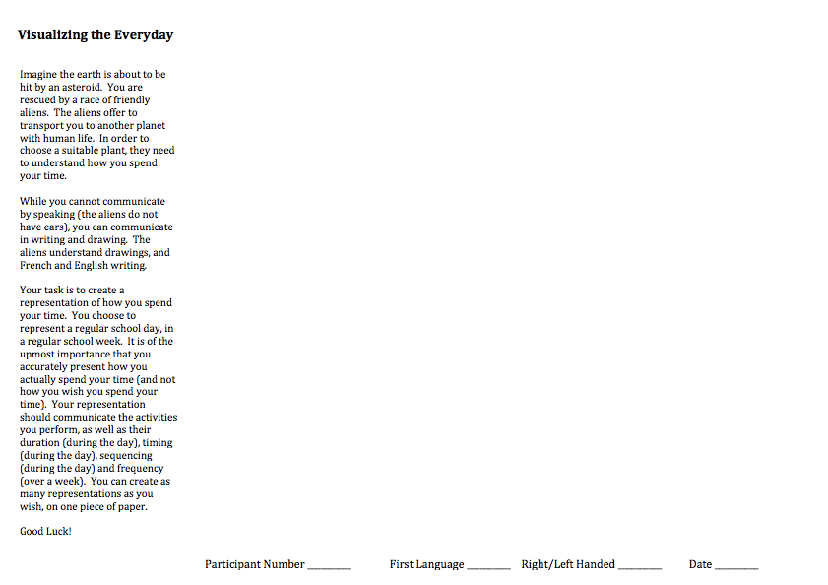


Materials
EMPIRICAL STUDY
Notes:
Although their participation was a requirement of their academic course, we wanted to motivate students to expend cognitive and creative effort on the activity.
We developed a humorous scenario. Imagine the earth is about to be destroyed by an asteroid. You are rescued by aliens, who will relocate you to a suitable planet. In order to decide which planet, you must communicate to the aliens how you usually spend your time on typical school day in a typical week.
While there are many purposes for external representation (i.e. persuasion, problem solving, exposition, planning) the scenario was constructed to prompt graphic productions in the most general case: informative communication.
The scenario explicitly called for representation of five components: activity (what), duration (quantity), timing (chronological point in time), sequence (order) and frequency (number of times).
They were instructed to create as many representations as necessary, using any graphic conventions desired. The text was carefully worded to use only the term “representation” when referring to the graphic output, avoiding a bias in visual forms with words such as: chart, graph, picture, sketch, icon, or text.
The students were given one sheet of A4 paper, and had access to their own pens, pencils and colored highlighters.

Slide 28




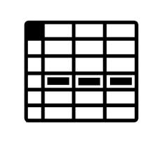
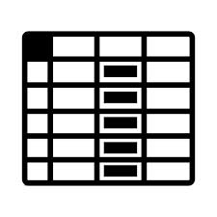
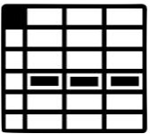




Analysis
1
3
v1
v3
2
v2
EMPIRICAL STUDY
Notes:
The coding scheme was developed by the author using a directed approach (Hsieh & Shannon, 2005).
First, categories were defined in response to the foreshadowing questions, in alignment with the discussion of form and space in Tversky (2011).
The author then reviewed a subset of diagrams (n=5), and applied the coding scheme. Multiple modifications were made during this inductive process, including the addition of two categories the researcher noted as present and variant in the sample, and removal of one category that proved too subjective to evaluate2. The researcher then developed operational definitions for each variable and set variable values that were exhaustive and mutually exclusive (Theo & Jewitt, 2004).
The resulting scheme was then applied to the diagrams by two additional raters, who coded the entire sample. Three graduate students in Cognitive Visualization (including the author) coded the resulting diagrams following the procedure for directed qualitative content analysis (see Hsieh & Shannon, 2005; Krippendorff, 1989; Patton, 2002, for a thorough description). The raters agreed on the operational definitions for each component in the coding scheme before analyzing two diagrams from the sample as a training exercise. After every five diagrams, the raters paused to discuss their evaluations, following the constant comparison method (Glasner & Strauss, 1967 as cited in Marsh & White, 2006). In the case of discrepancies, each rater explained their interpretation of the code, after which raters could revise or maintain their original assessment. In one case, a revision to an operational definition was proposed, and the corresponding components of the previously reviewed diagrams were re-evaluated. The final coding scheme reflects a response to the both the research questions and the evidence present in the sample. As the sample size (n=25) was small, each rater proceeded to code the entirety of the sample.

Slide 29


Analysis
(space) α = 0.876 (form) α = 1.000 (mechanisms) α = 0.972
4
5
EMPIRICAL STUDY
(Hayes & Krippendorff, 2007)
Notes:
(4) Coding results for the whole sample were then evaluated for interXrater reliability, with positive outcomes. Krippendorff ‘s alpha was selected as the most appropriate measure of reliability for nominal variables assessed by more than two coders (Hayes & Krippendorff, 2007). For use of space (S1XS6) α = 0.876, use of form (F1XF5) α = 1.000 and primary mechanisms (M1XM5) α = 0.972, all exceeding the recommended threshold of α ≥ 0.800 (Geertzen, 2012; Lombard, SnyderXDuch, & Bracken, 2004).
(5) Finally, a combined coding result was constructed from the individual results (based on the majority rating) for use in data analysis.

Slide 30
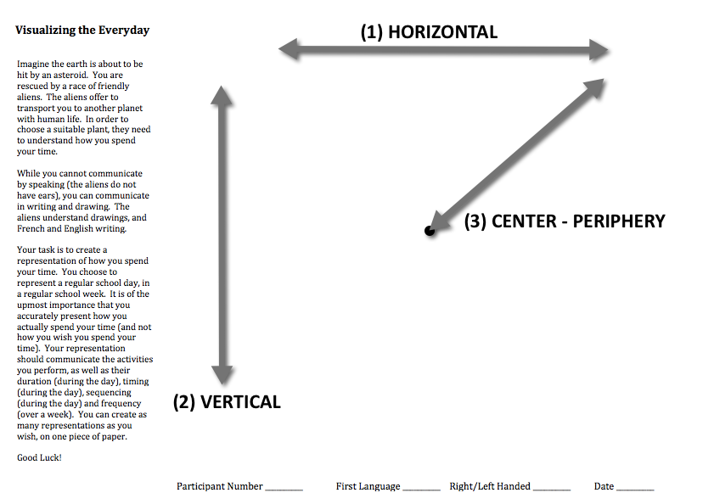
Analysis : Space
(4) CW - CCW
EMPIRICAL STUDY
Notes:
We first analyzed the diagrams for their use of space.
We determined if the Gestalt use of space was primarily linear or circular.
Then we evaluated the direction of the flow of information.
For linear representations, we evaluated the direction in horizontal and vertical
For circular representations, we evaluated the direction along the circumference, and along the radius.

Slide 31
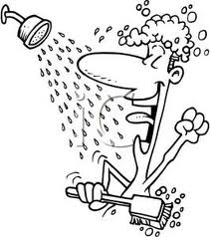

Analysis : Form
(1) TEXT
i am some text la la la la lah
(2) NUMBER
12pm - 4 am; 2 x
(3) ARROW
(4) DRAWING
(4) COLOR
EMPIRICAL STUDY
Notes:
We then analyzed the diagrams for their use of form.
Each diagram was coded yes/no to see if they contained
text
number
arrow
drawing
color

Slide 32
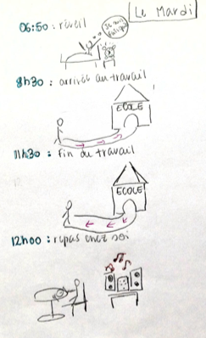
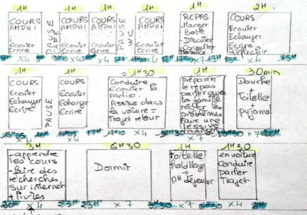
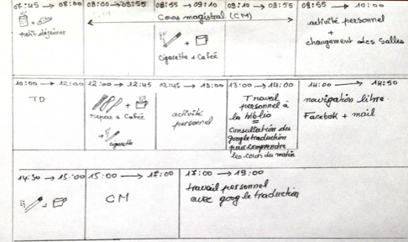
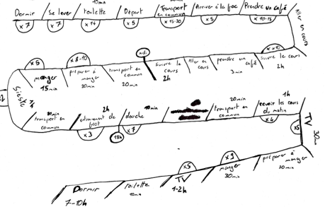
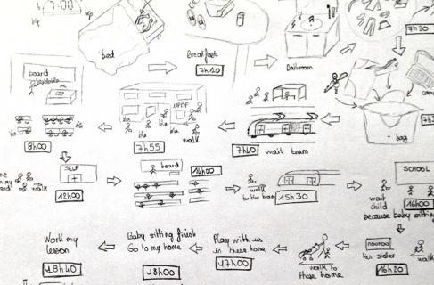
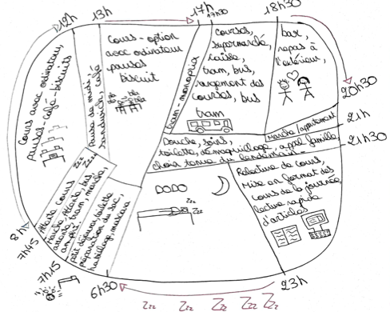

Slide 33
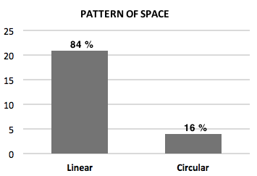
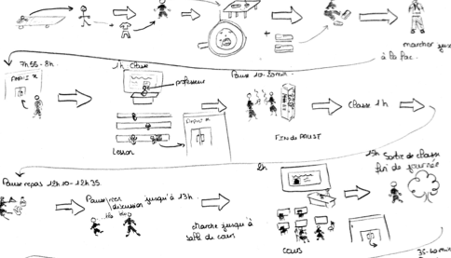
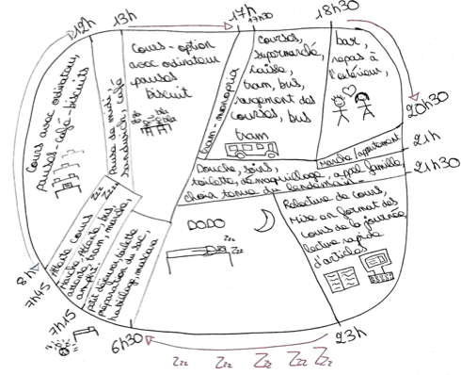
Use of Space
Results
Notes:
Of the 25 diagrams analyzed,
84% (21) were characterized by a linear flow of information.

Slide 34
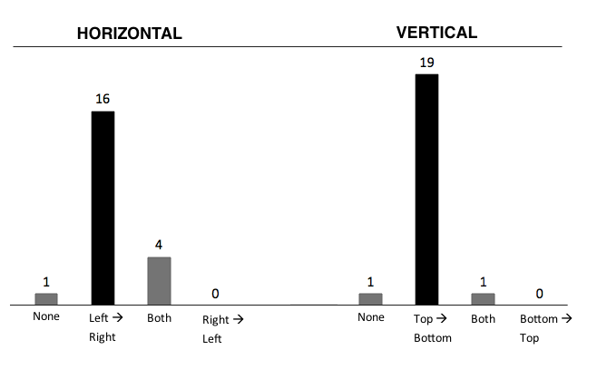
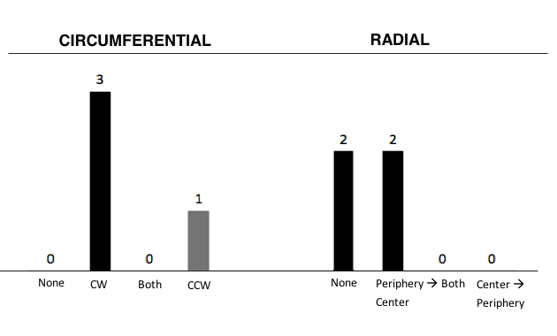
Results
Notes:
In this set, 76% (16) adopted a left to right horizontal orientation, while 20% (4) alternated left to right and right to left. 90% adopted a top to bottom vertical orientation

Slide 35
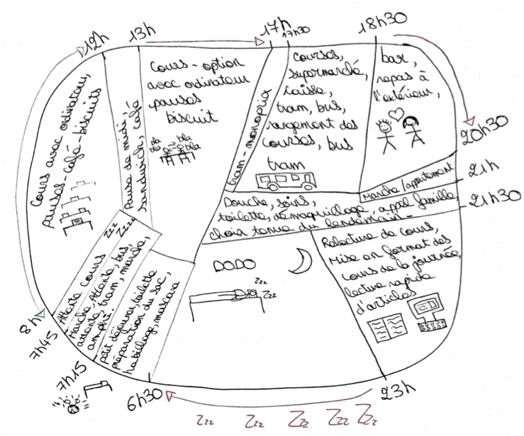
Results
Notes:
diagram 1 is in the majority right->left, top->bottom
diagram 2 is the “snake” form, we found 4 of these, but they always used line or arrow to indicate the direction of flow was changing.
diagram 3 is a typical circular form
diagram 4 is the only CCW circular representation

Slide 36
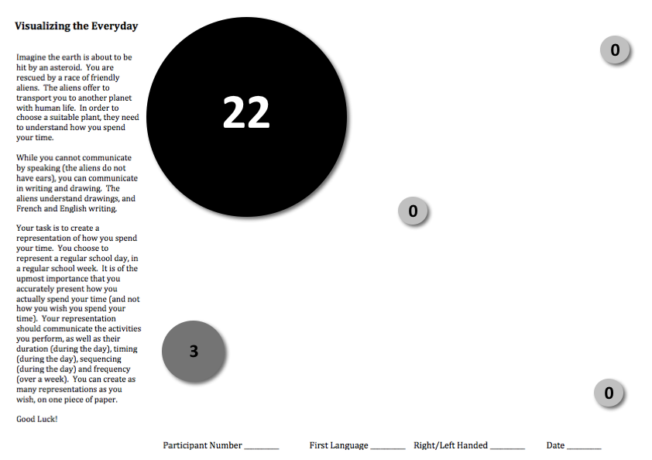
Results
Notes:
Nearly all of the students (88%) depicted the start of their day in the upper left corner of the page. Of the remaining three, two were circular representations and one was linear.

Slide 37
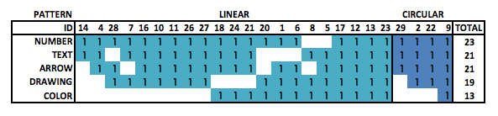
Use of Form
Results
Notes:
The most frequently used form was numbers at, with the least frequent being color at 52%. Five diagrams made use of all five types of form evaluated. Visual examination of the frequency distribution suggests a relationship between the use of number and text, and drawing and color, though the sample was too small to evaluate statistical correlation.

Slide 38
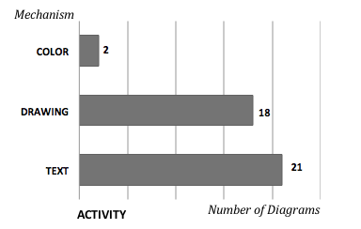
Primary Mechanisms
Results
Notes:
Our first prediction was the use of realistic drawings and text to depict activities. Comparison of frequency in the coded data supports this hypothesis, with 80% of the sample using text, and 70% using drawings. Two novel representations differentiated activities through the use of color. 60% of the drawings used both text and drawing, and all three raters noted the use of text to mitigate poorly executed sketches.

Slide 39
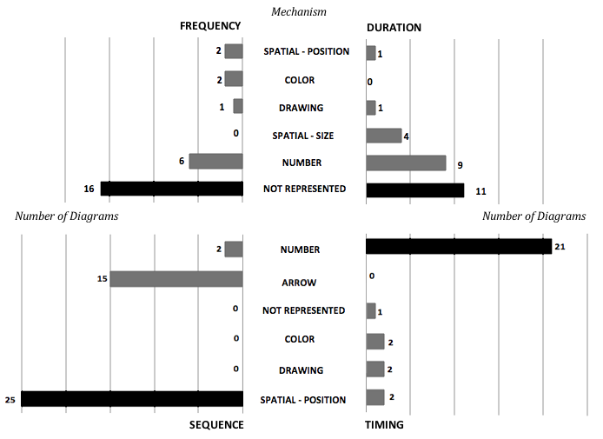
Results
Notes:
Only four individuals managed to represent all four components of time use. Frequency was the most commonly neglected component, followed by duration, then timing. When represented, numbers were consistently used to depict frequency and duration. Our second hypothesis was that duration and frequency would be described using statistical graphs, independent of the more depictive activity data. Surprisingly, none of the results diagrams included statistical graphs.
Our last hypothesis was the use of spatial positioning on the horizontal dimension to represent timing and sequence. 100% of the drawings used spatial position to represent sequence, however only 2 diagrams used it to represent timing. These two novel representations were both circular, positioning activities around the corresponding place in space on the face of a clock to indicate the time they occurred.

Slide 40
Conclusion
Preference for linear over circular
Directionality consistent with written language
Variety of forms
Difficult to represent all components in 1 diagram
Spatial-position to represent sequence
Preference for single integrated diagram
Many resembled agendas and calendars
quantitative content analysis w/ large random sample
differentiate communicative purpose
students of different majors
correlation with attitude toward time
correlation with planning methods
EMPIRICAL STUDY

Slide 42
At a first glance, everyday life seems to be very simple and everybody has experiences from it, but when we try to investigate it from a scientific perspective, its complexity is overwhelming.
- Kajsa Ellegård
CONCLUSION
(Ellegård, 2004)
Notes:
In conclusion this afternoon, I’d like to leave you with another quotation, this time from Kajsa Ellegard, a student of Thorsten Hagerstrand.
This semester I learned that time use is the study of how we use our time… but it’s complexity is overwhelming. This complexity reflects a wealth of opportunity for investigation in both cognitive science and visualization.

Slide 43
UN. (2013). Guidelines for Harmonizing Time-Use Surveys (p. 129).
Eurostat. (2008). Harmonised European time use surveys: 2008 Guidelines. Statistics Office of the European Union. Hägerstrand, T. (1989). Reflections On “What About People in Regional Science?” Papers of the Regional Science Association, 66, 1–6.
Thrift, N. (1977). An introduction to time-geography. Geo Abstracts, University of East Anglia. Ellegård, K., & Cooper, M. (2004). Complexity in daily life–a 3D-visualization showing activity patterns in their contexts. electronic International Journal of Time Use Research, 1(1), 37–59.
Vrotsou, K., Ellegård, K., & Cooper, M. (2009). Exploring time diaries using semi-automated activity pattern extraction. electronic International Journal of Time Use Research, 6(1), 1–25.
Lesnard, L. (2004). Schedules as sequences: a new method to analyze the use of time based on collective rhythm with an application to the work arrangements of French dual-earner couples. electronic International Journal of Time Use Research, 1(1), 60–84.
Michelson, W., & Crouse, D. (2004). Examining large-scale time-use files through graphic representation. electronic International Journal of Time Use Research, 1(1), 85–100. Aigner, W., Miksch, S., Müller, W., Schumann, H., & Tominski, C. (2008). Visual methods for analyzing time-oriented data. IEEE transactions on visualization and computer graphics, 14(1), 47–60. doi:10.1109/TVCG.2007.70415
Tversky, B., Kugelmass, S., & Winter, A. (1991). Cross-cultural and developmental trends in graphic productions. Cognitive Psychology, 23, 515–557. doi:10.1016/0010-0285(91)90005-9
Tversky, B. (2011). Visualizing Thought. Topics in Cognitive Science, 3(3), 499–535. doi:10.1111/j.1756-8765.2010.01113.x
Marsh, E., & White, M. (2006). Content analysis: A flexible methodology. Library trends, 55(1), 22–45. doi:10.1353/lib.2006.0053
Hayes, A. F., & Krippendorff, K. (2007). Answering the Call for a Standard Reliability Measure for Coding Data. Communication Methods and Measures, 1(1), 77–89. doi:10.1080/19312450709336664

